Slide 1


BUA 751 : Machine Learning for Business
Energy Efficiency - Final Project: Group 1
Priyamvada Barve
Nandita Pathardikar
Prasun Abhishek Singh

Slide 2

Dataset Description
Our Dataset contains data on the energy efficiency of buildings.
X Variables :
Eight attributes (numbered x1….x8)
The two target variables in the dataset are:
Heating Load (y1) and Cooling Load (y2)
Amount of heating and cooling required to maintain a comfortable indoor temperature.
We aim to use these eight attributes to classify the two response variables y1 and y2.

Slide 3
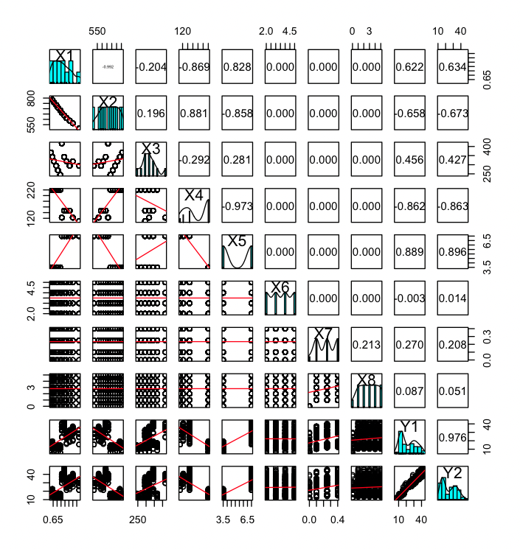
Visualization
This visualization is representing relationship between heating load and cooling load with all independent variables.

Slide 4
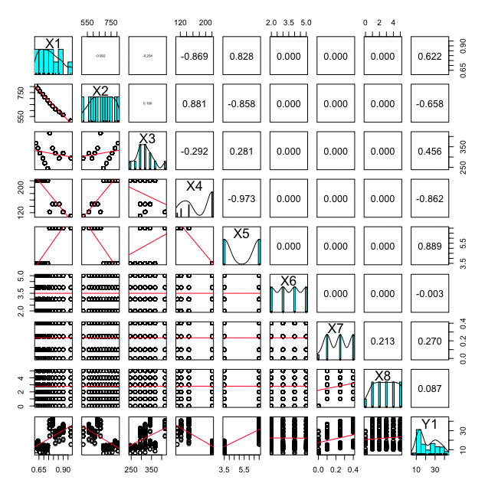
Visualization
This visualization is representing relationship between heating load with all independent variables.

Slide 5
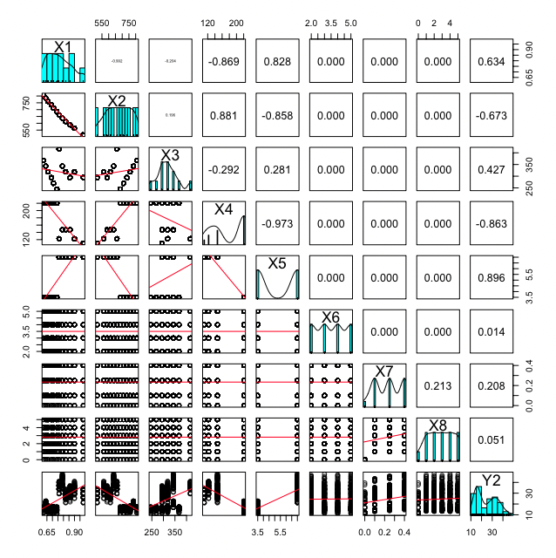
Visualization
This visualization is representing relationship between cooling load with all independent variables.

Slide 6
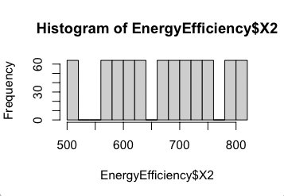
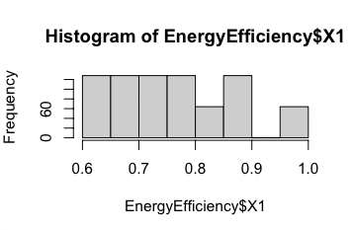
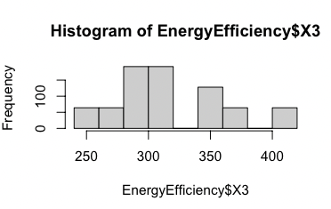
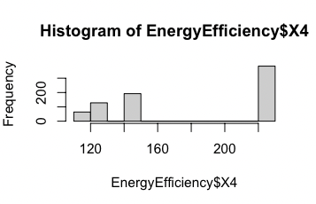
Histograms
X2 – surface area
X1 -Relative compactness
X3 – wall area
X3 – roof area

Slide 7
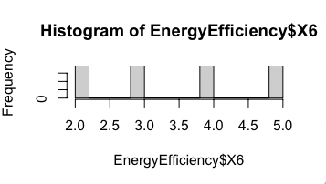
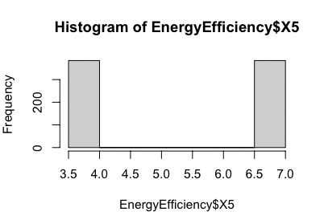
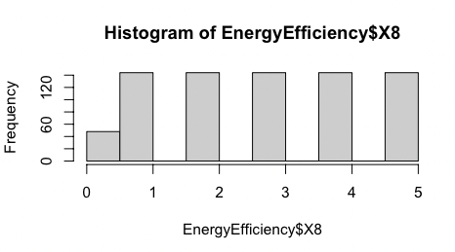
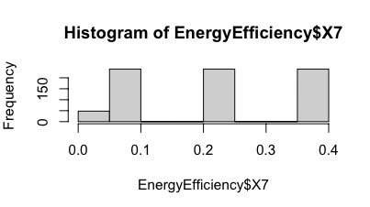
Histogram
X6 - Orientation
X5 – Overall height
X7 – Glazing Area Distribution
X7 – Glazing Area

Slide 8
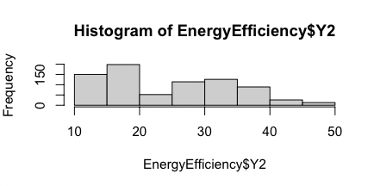
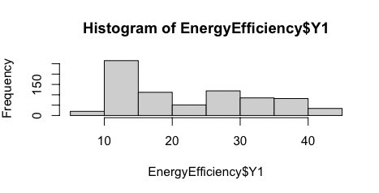
Histogram for output
Cooling Load
Heating Load

Slide 9
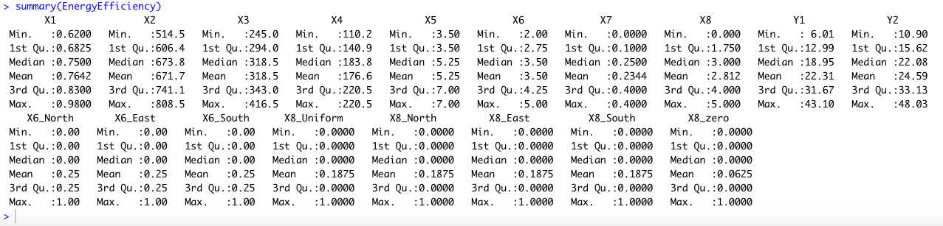
Statistical Analysis
Statistical analysis is used to analyze and present data in such a way that it is easy to interpret.
Using summary() function we can get an overview of data.

Slide 10
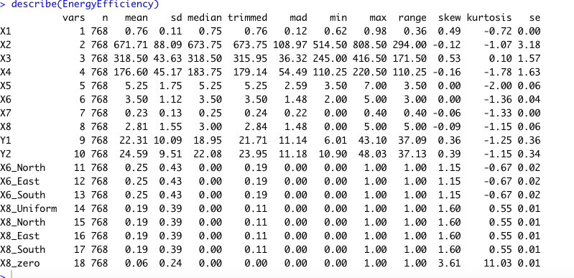
Statistical Analysis
Describe() function can be used to provide a more detailed summary of the data.

Slide 11
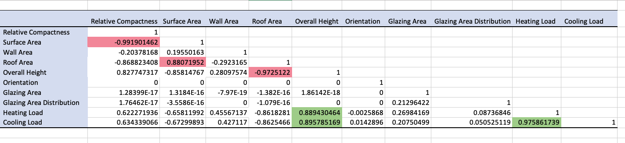
Correlation Matrix

Slide 12
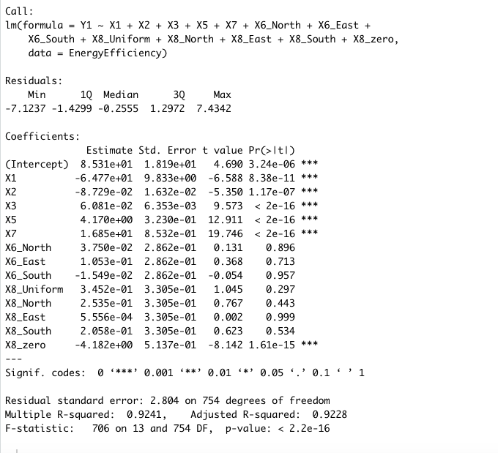
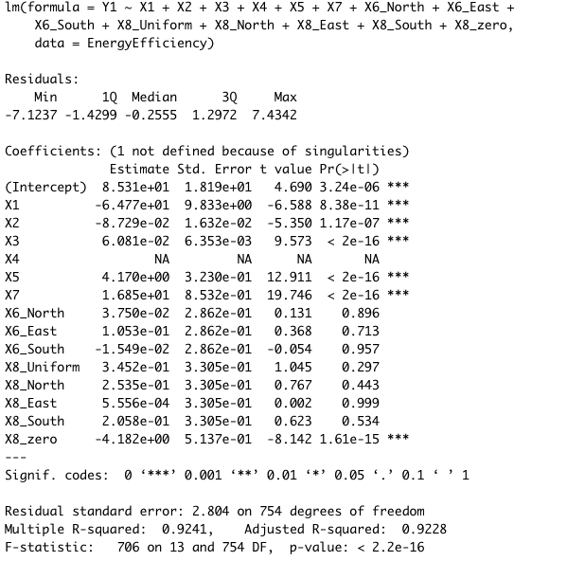
Linear Regression
We can see that accuracy of the model is the same even after removing X4 variable, as it was collinear with other variables.
Notes:
After running linear regression model for the Heating Load, we observed that X4 variable is collinear with one or more of the other predictor variables therefore, we removed X4 to see if it affects accuracy of our model.

Slide 13
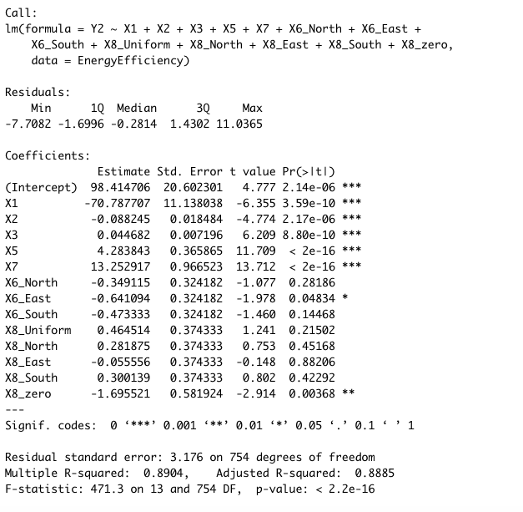
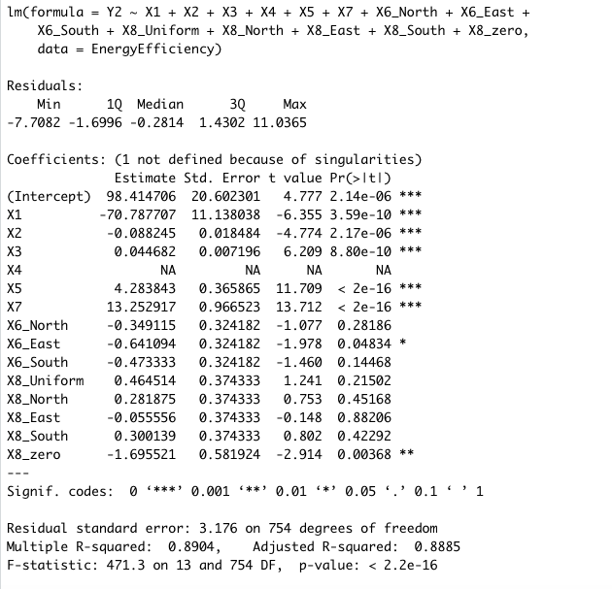
Linear Regression
We can see that accuracy of the model is the same even after removing X4 variable, as it was collinear with other variables.
Notes:
After running linear regression model for the Cooling Load, we observed that X4 variable is collinear with one or more of the other predictor variables therefore, we removed X4 to see if it affects accuracy of our model.

Slide 14
VIF
VIF (Variance Inflation Factor) can be used to identify multicollinearity by assigning each attribute a score.
A VIF value of less than 10 indicates that the predictor variable is not highly correlated with the other predictor variables in the regression model, and therefore, there is no serious multicollinearity problem.
To remove multicollinearity, we can remove correlated independent variables or combine them.

Slide 15
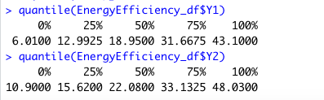
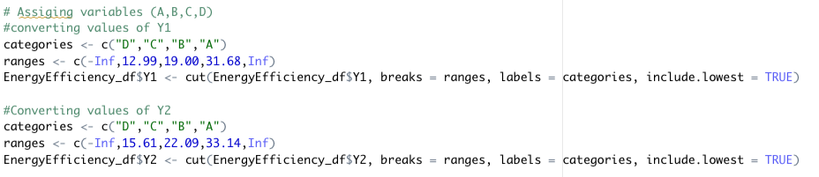
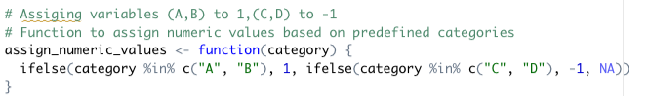
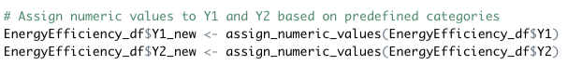
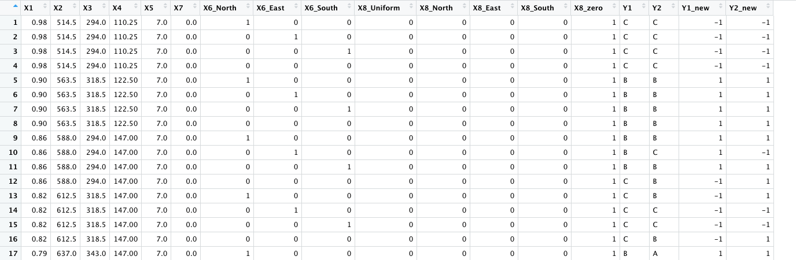
Assigned Categories according to Quartile

Slide 16
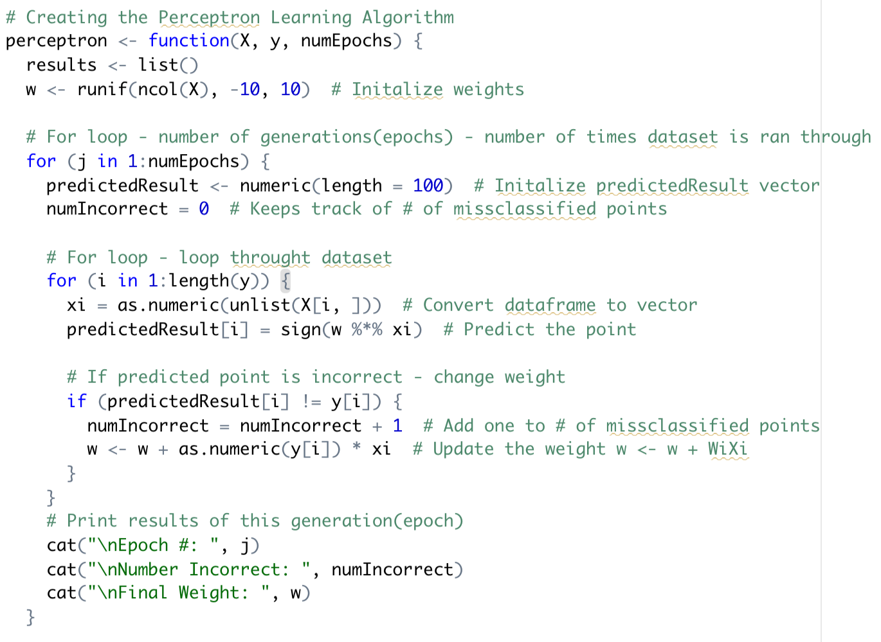
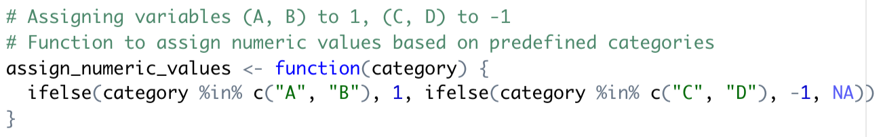
Perceptron
Perceptron takes different groups of observations and tries to separate them with a straight line,
Perceptron can separate only into 2 groups.
There are many solutions to separate the groups.

Slide 17
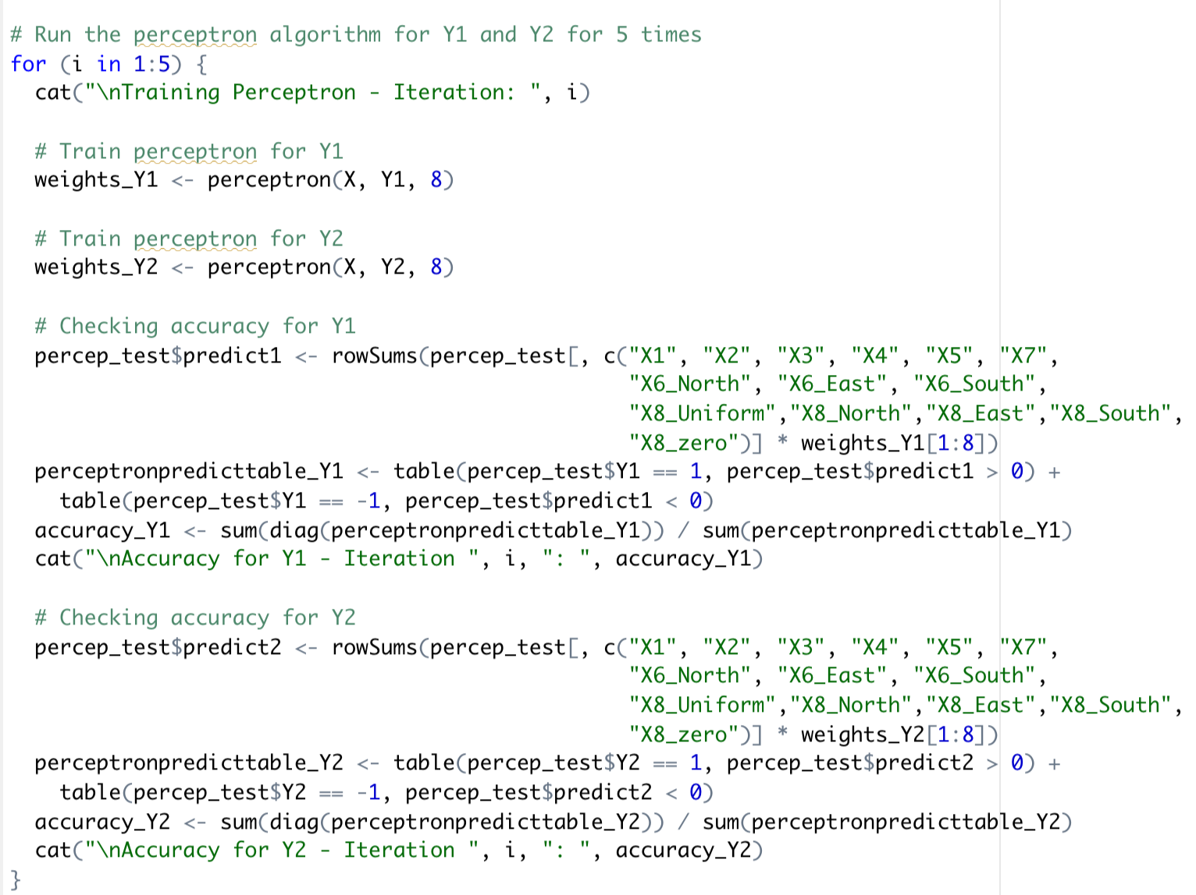
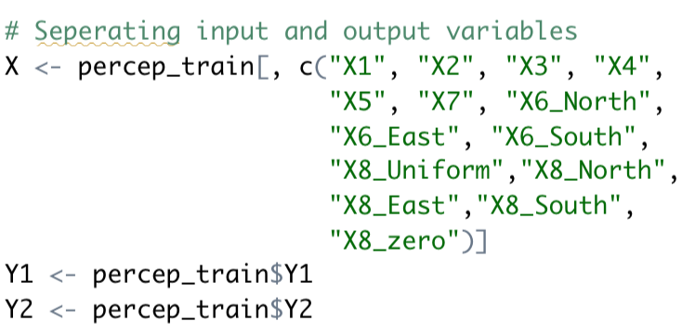
Perceptron – loops

Slide 18
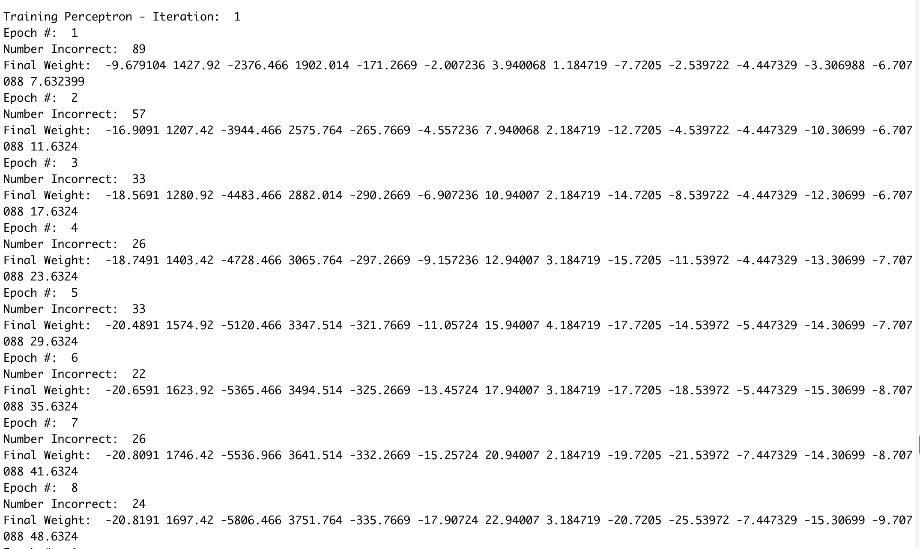
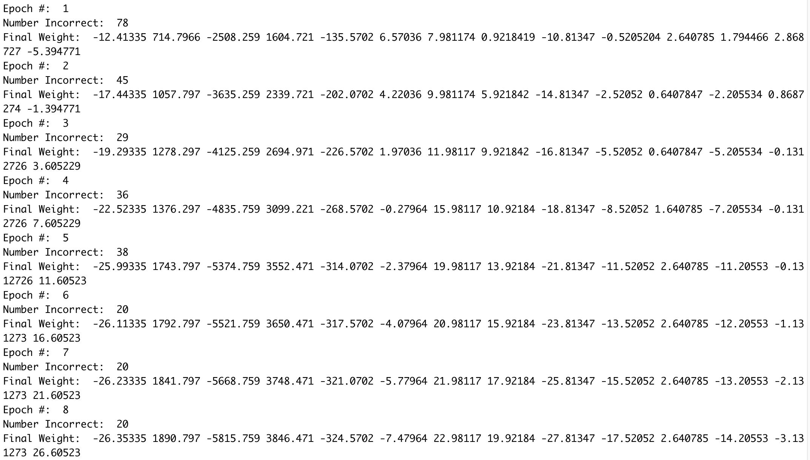
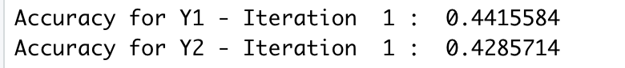
Perceptron – iteration 1
The number of incorrect predictions decreases at each Epoch, and the weight vector changes at each epoch, which indicates that the perceptron is learning to classify the data more accurately and adjusting its decision boundary to better separate the data.

Slide 19
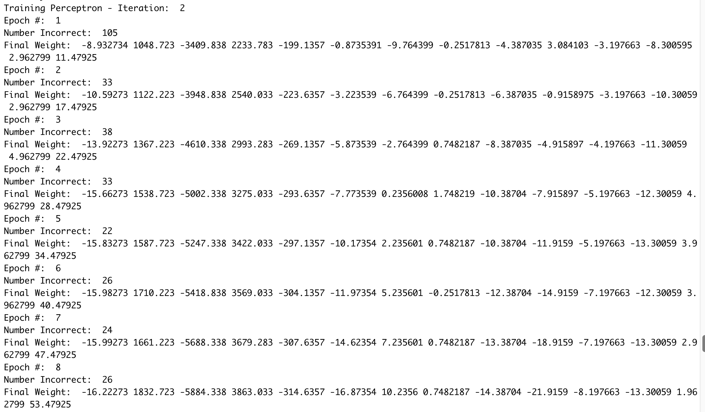
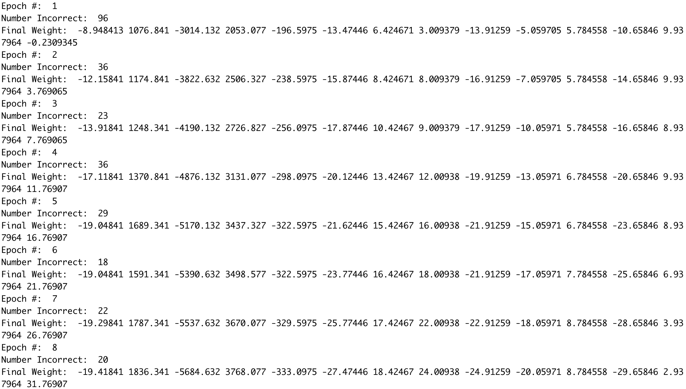
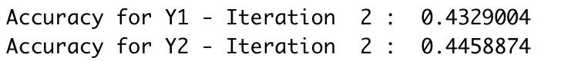
Perceptron – iteration 2

Slide 20
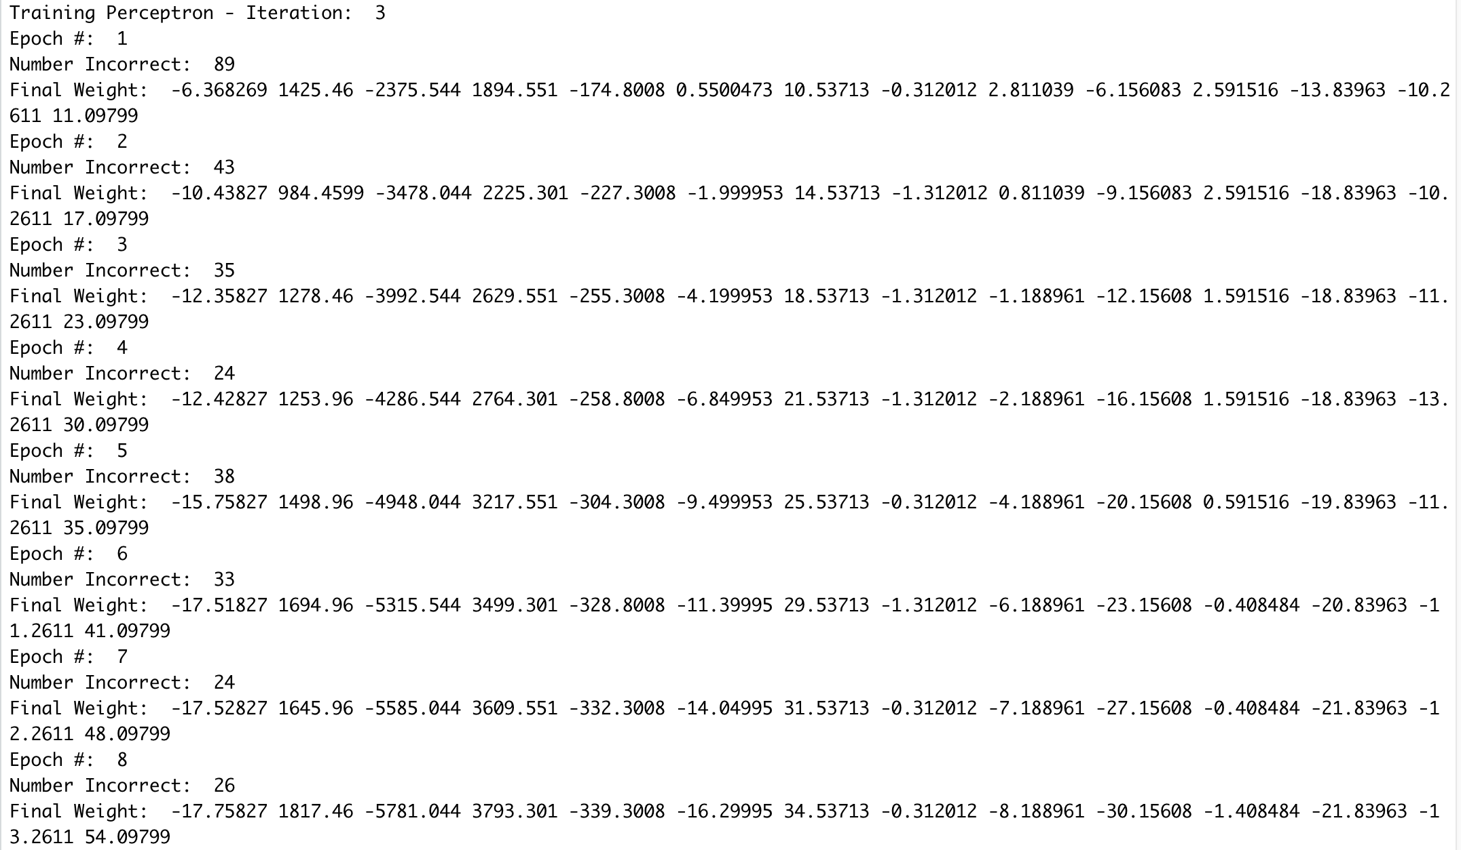
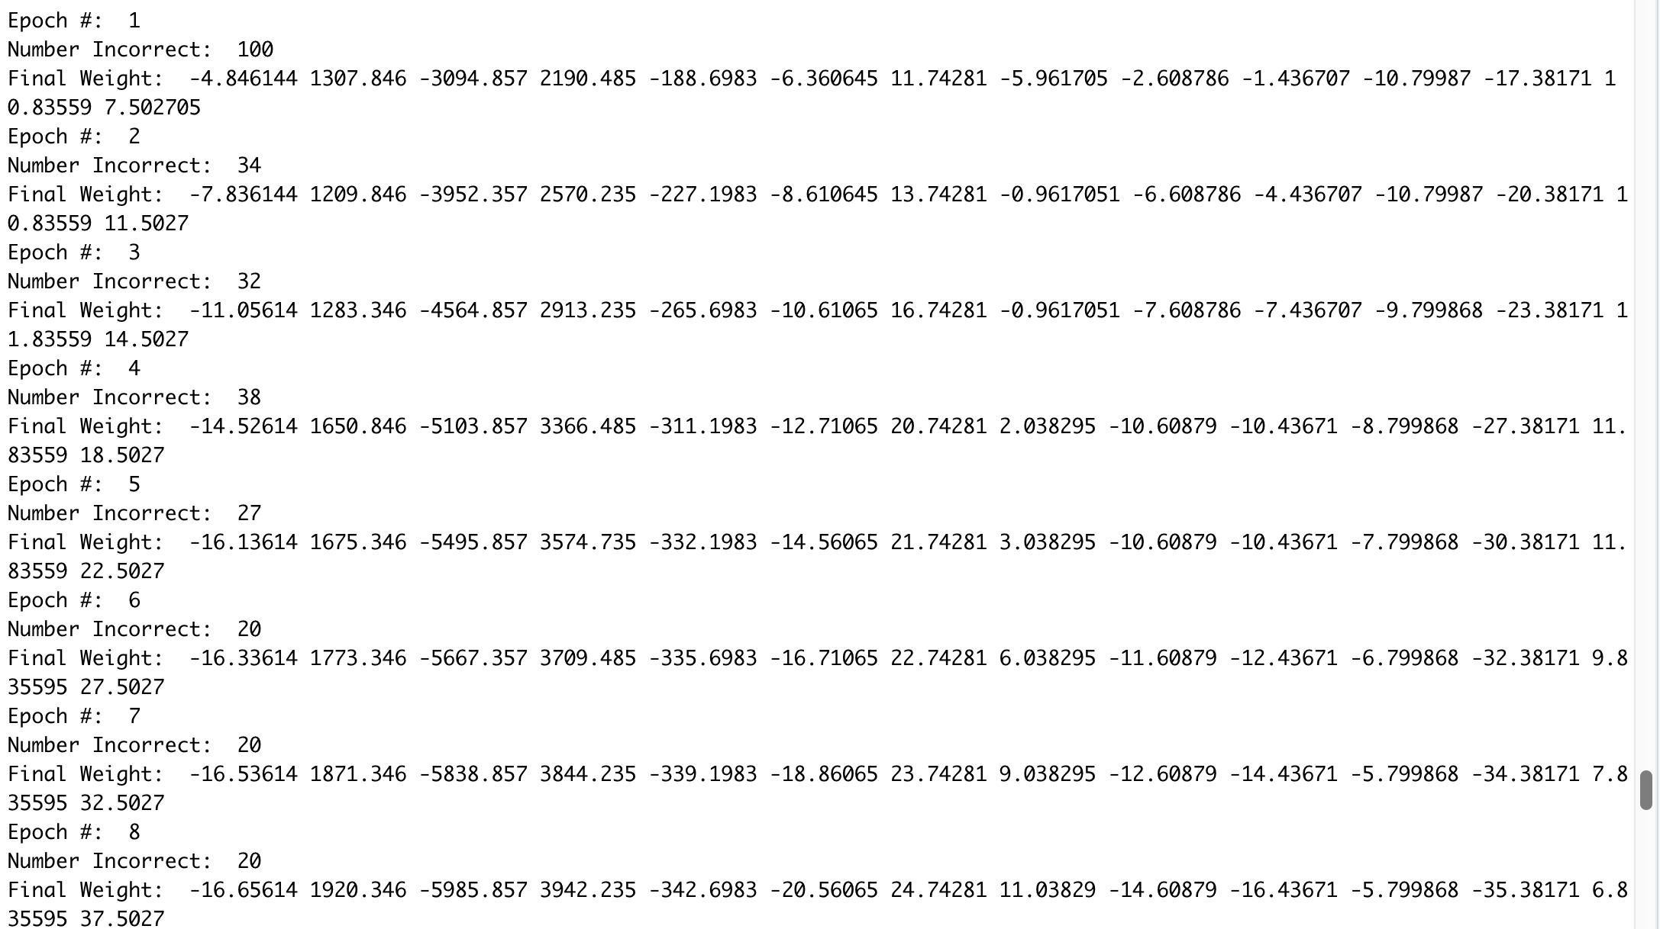
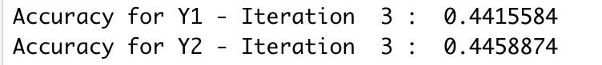
Perceptron – iteration 3

Slide 21
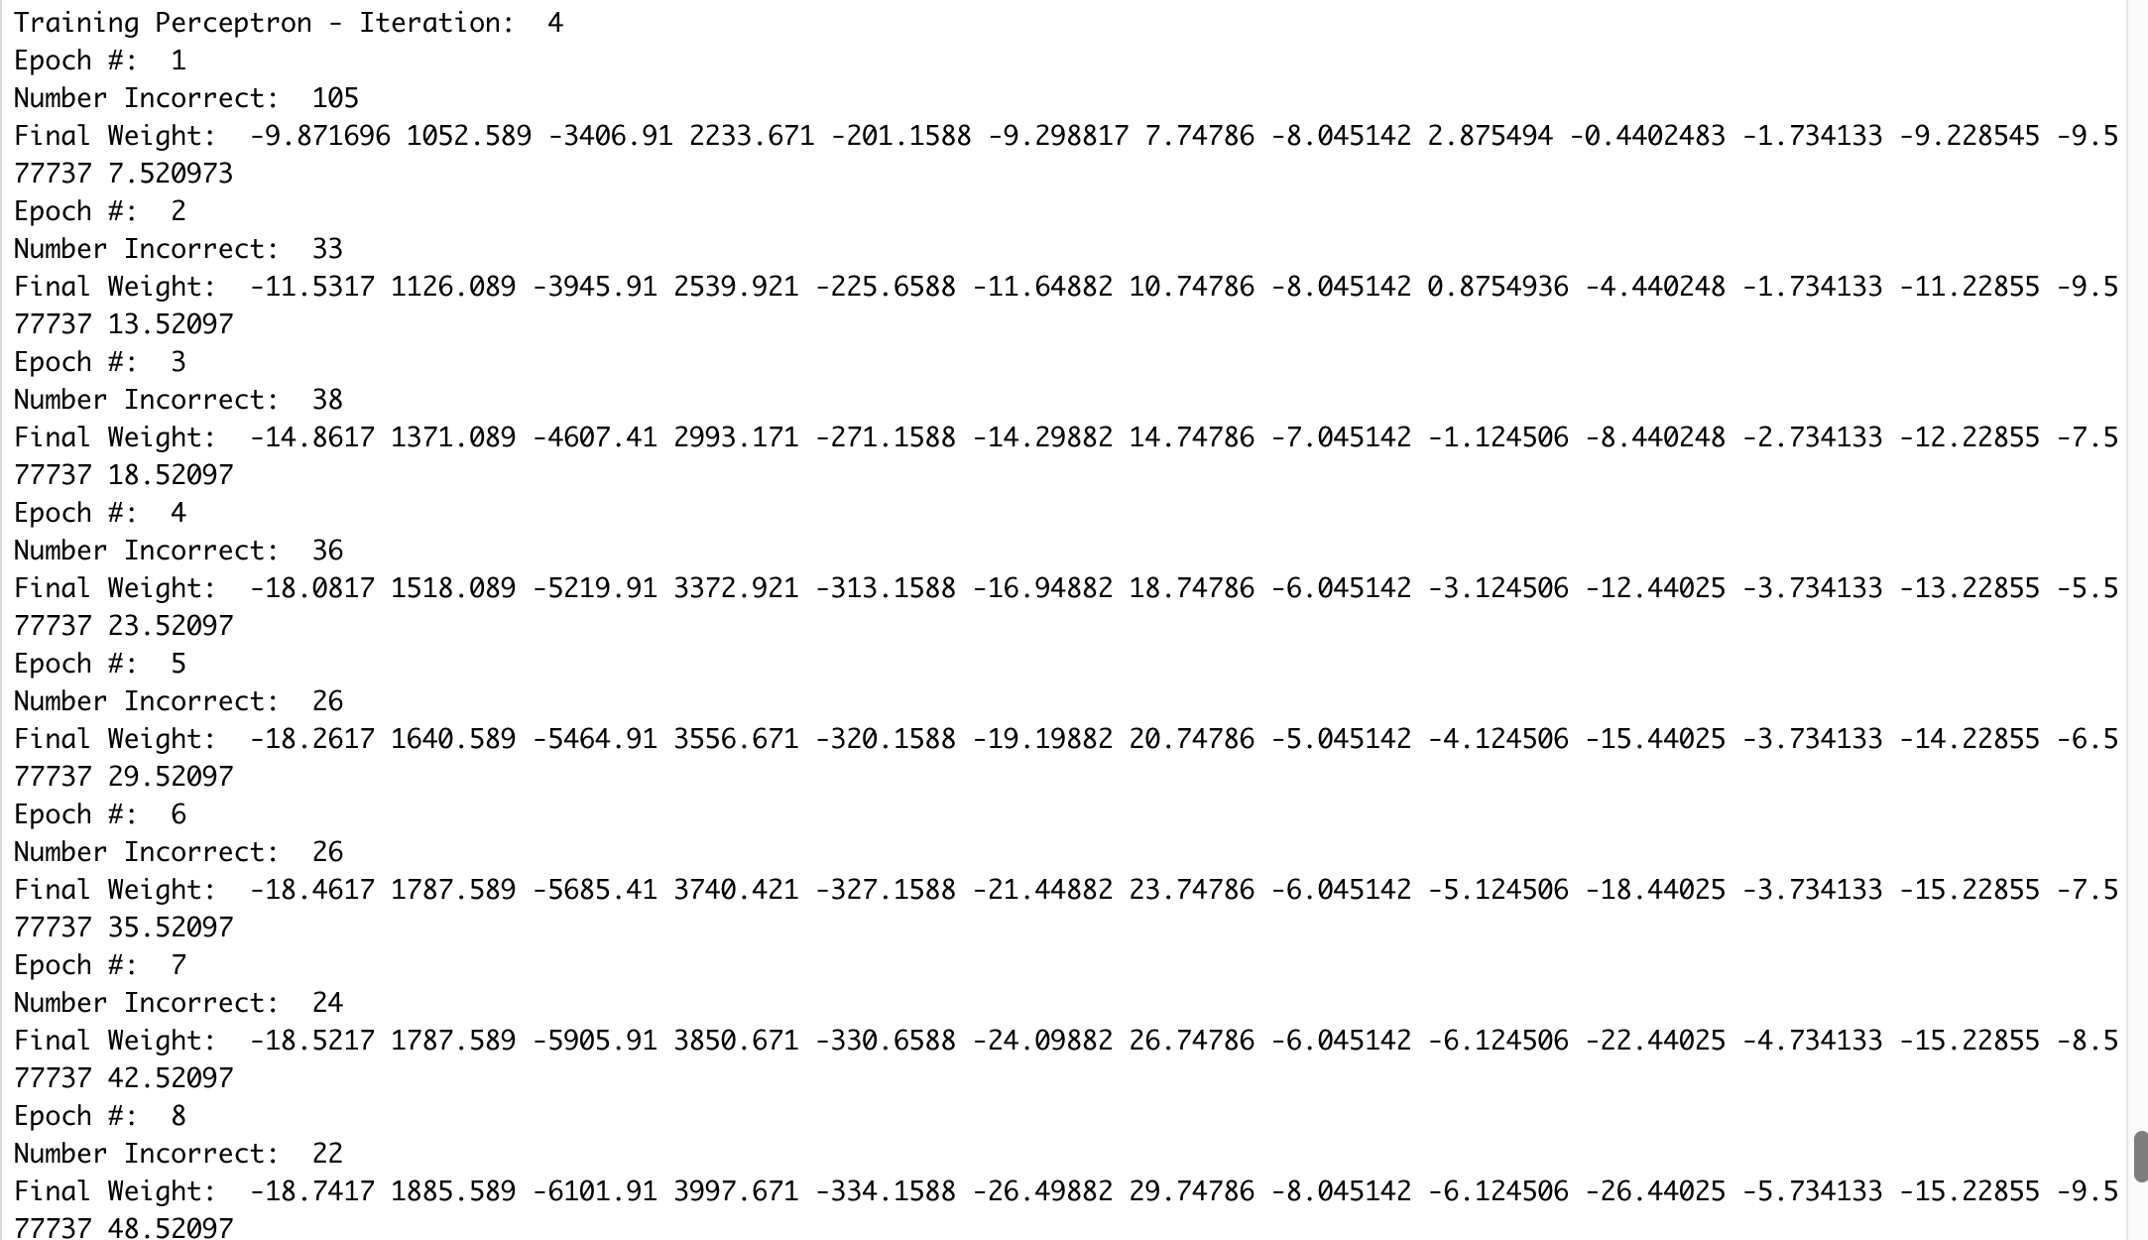
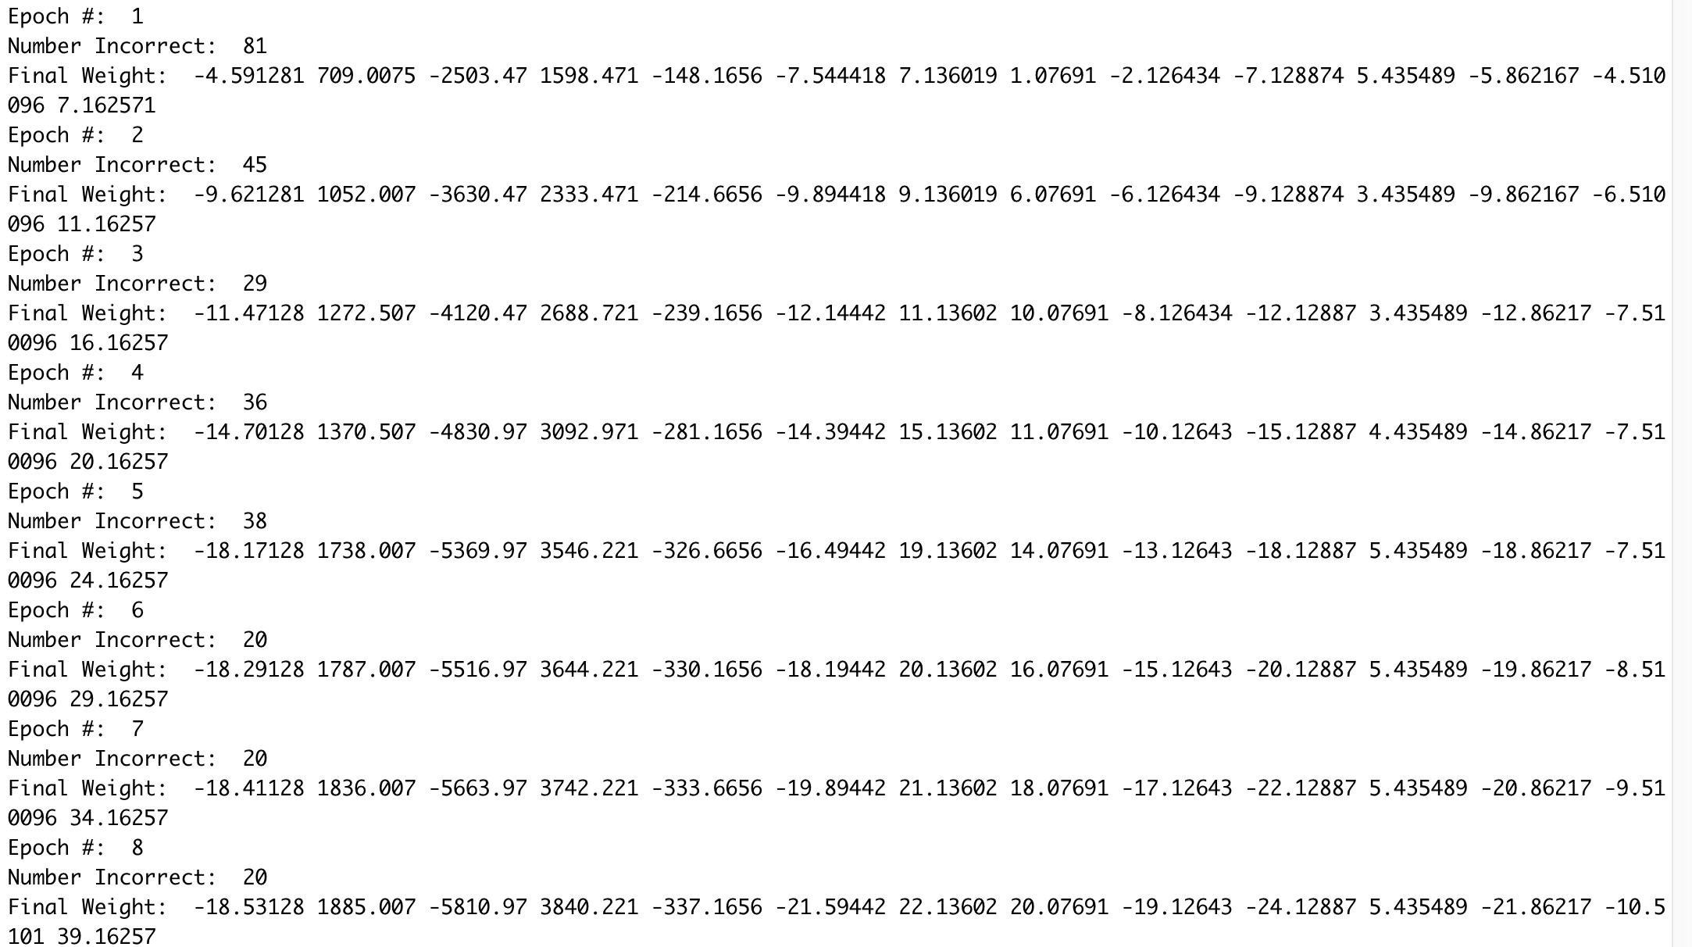
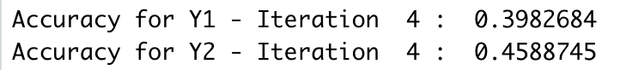
Perceptron – iteration 4

Slide 22
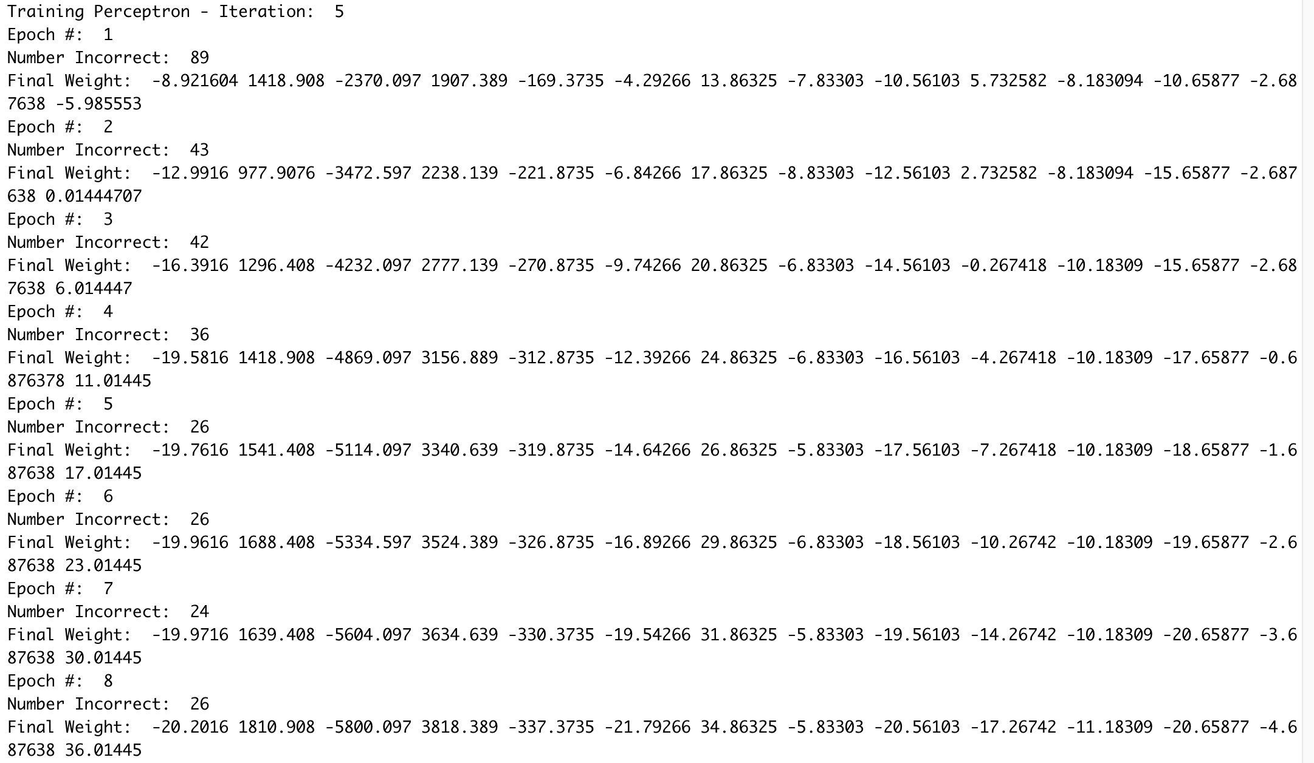
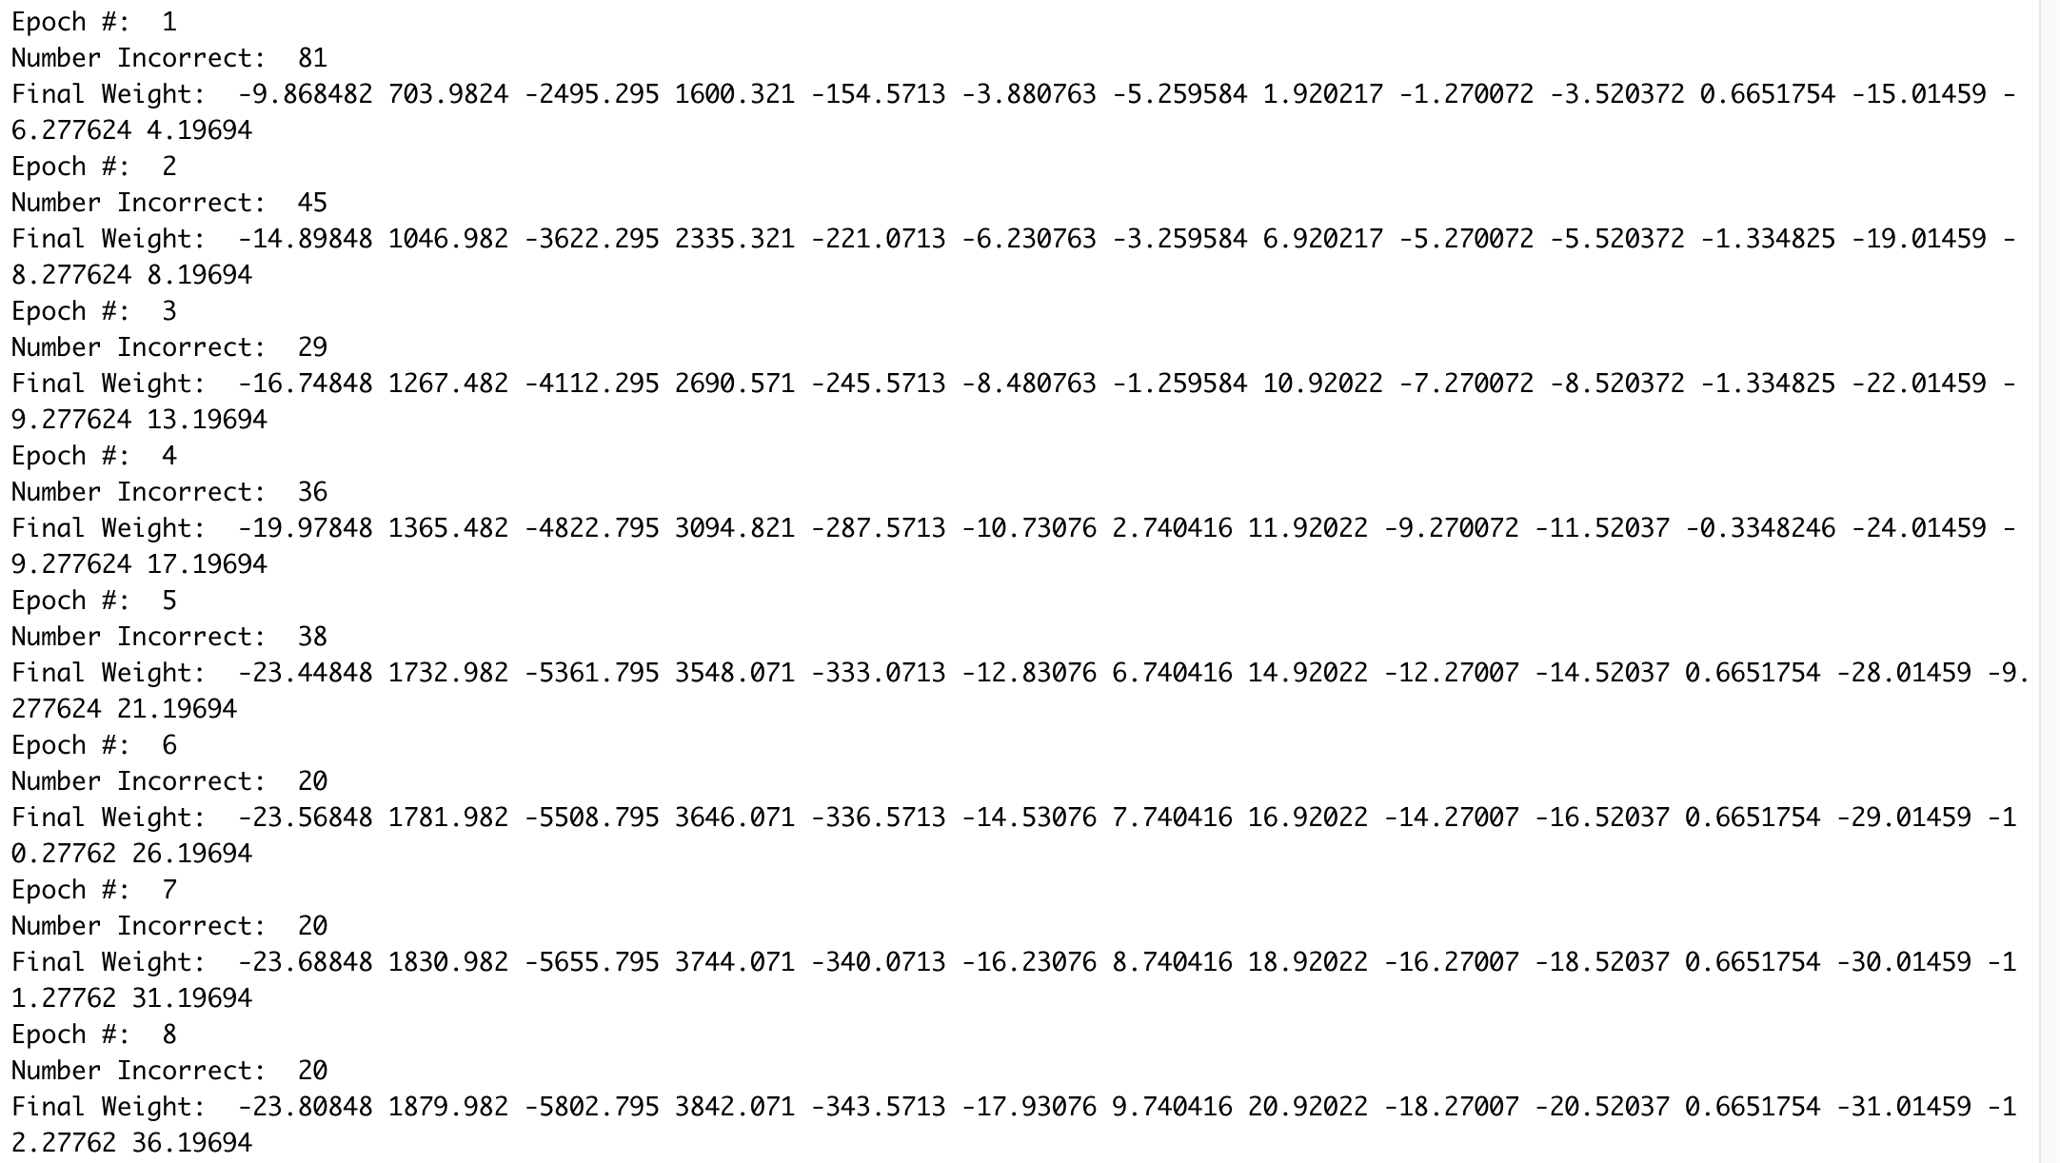
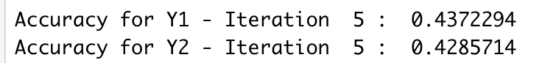
Perceptron – iteration 5

Slide 23
Accuracy of all 5 iteration of Perceptron model

Slide 24

SVM
Support vector machines (SVM) are a technique to separate data into groups based on its characteristics.

Slide 25
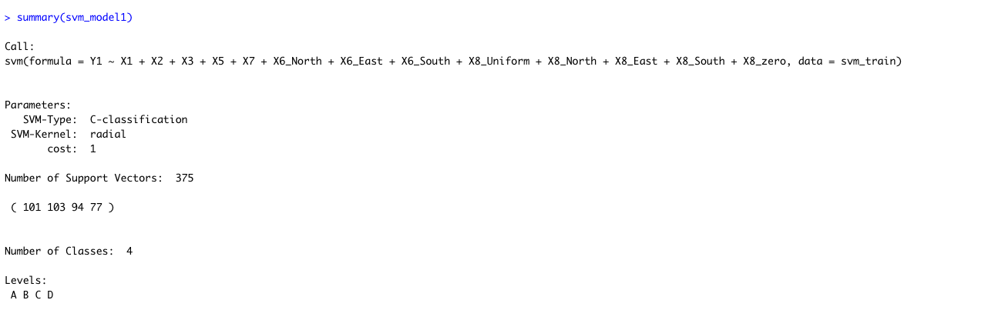
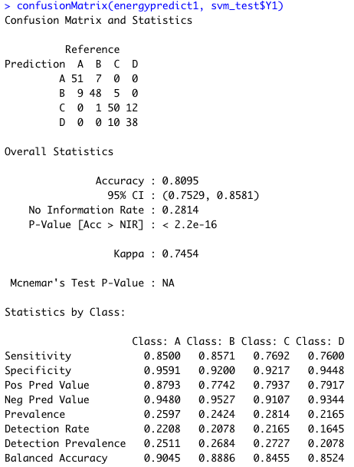
Support Vector Machine – Model 1

Slide 26
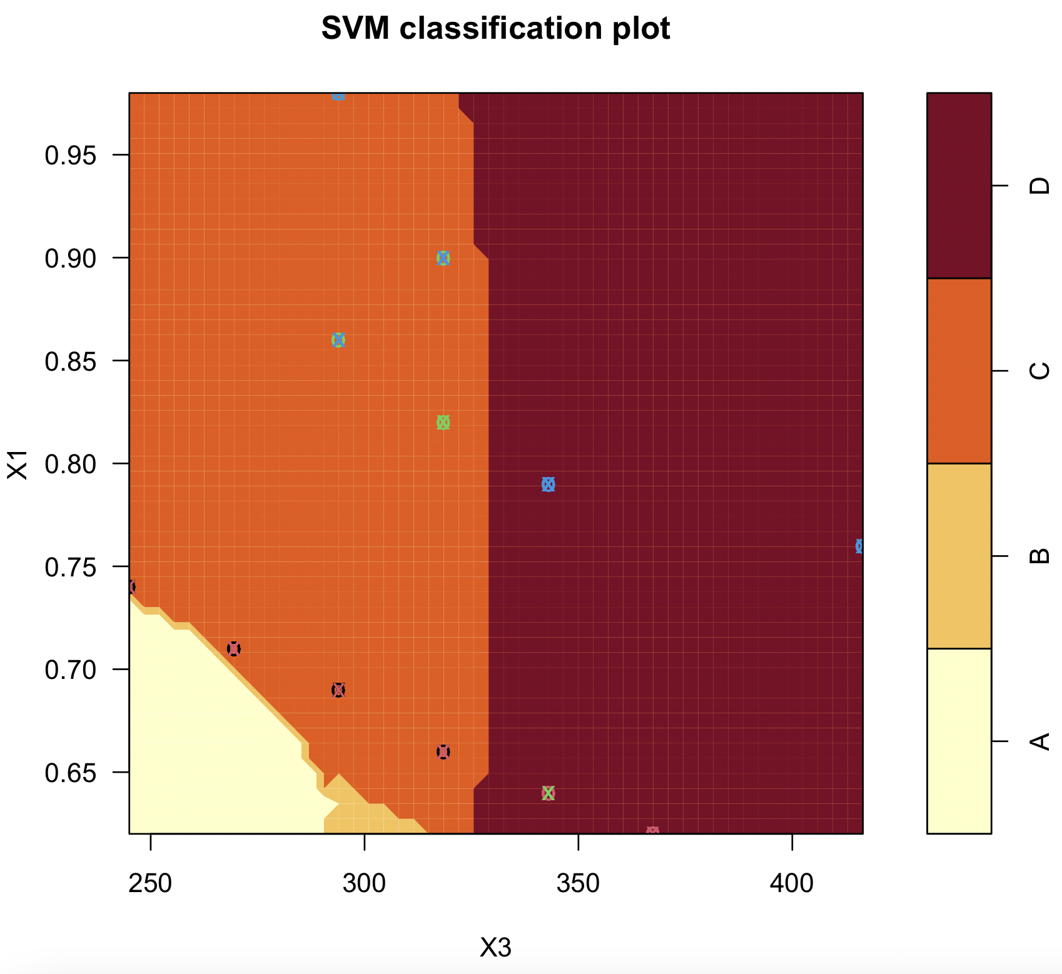
Support Vector Machine – Model 1
The SVM classification plot in
the image shows a wide
margin, which indicates that the
SVM model is able to separate the
four classes very well. This is a
good sign, because it means that
the model is likely to generalize
well to new data.

Slide 27
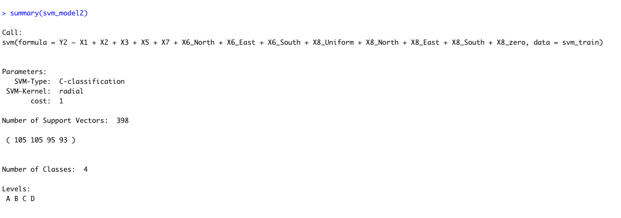
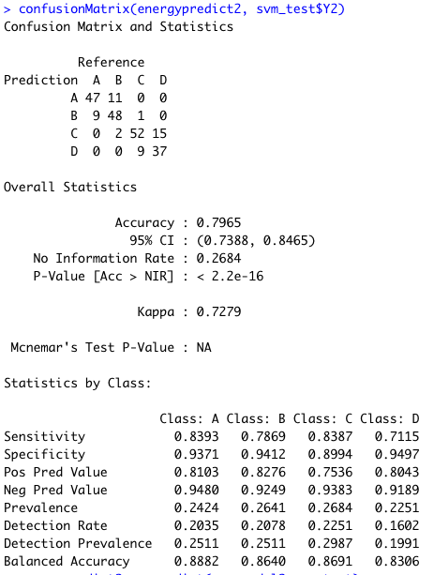
Support Vector Machine – Model 2

Slide 28
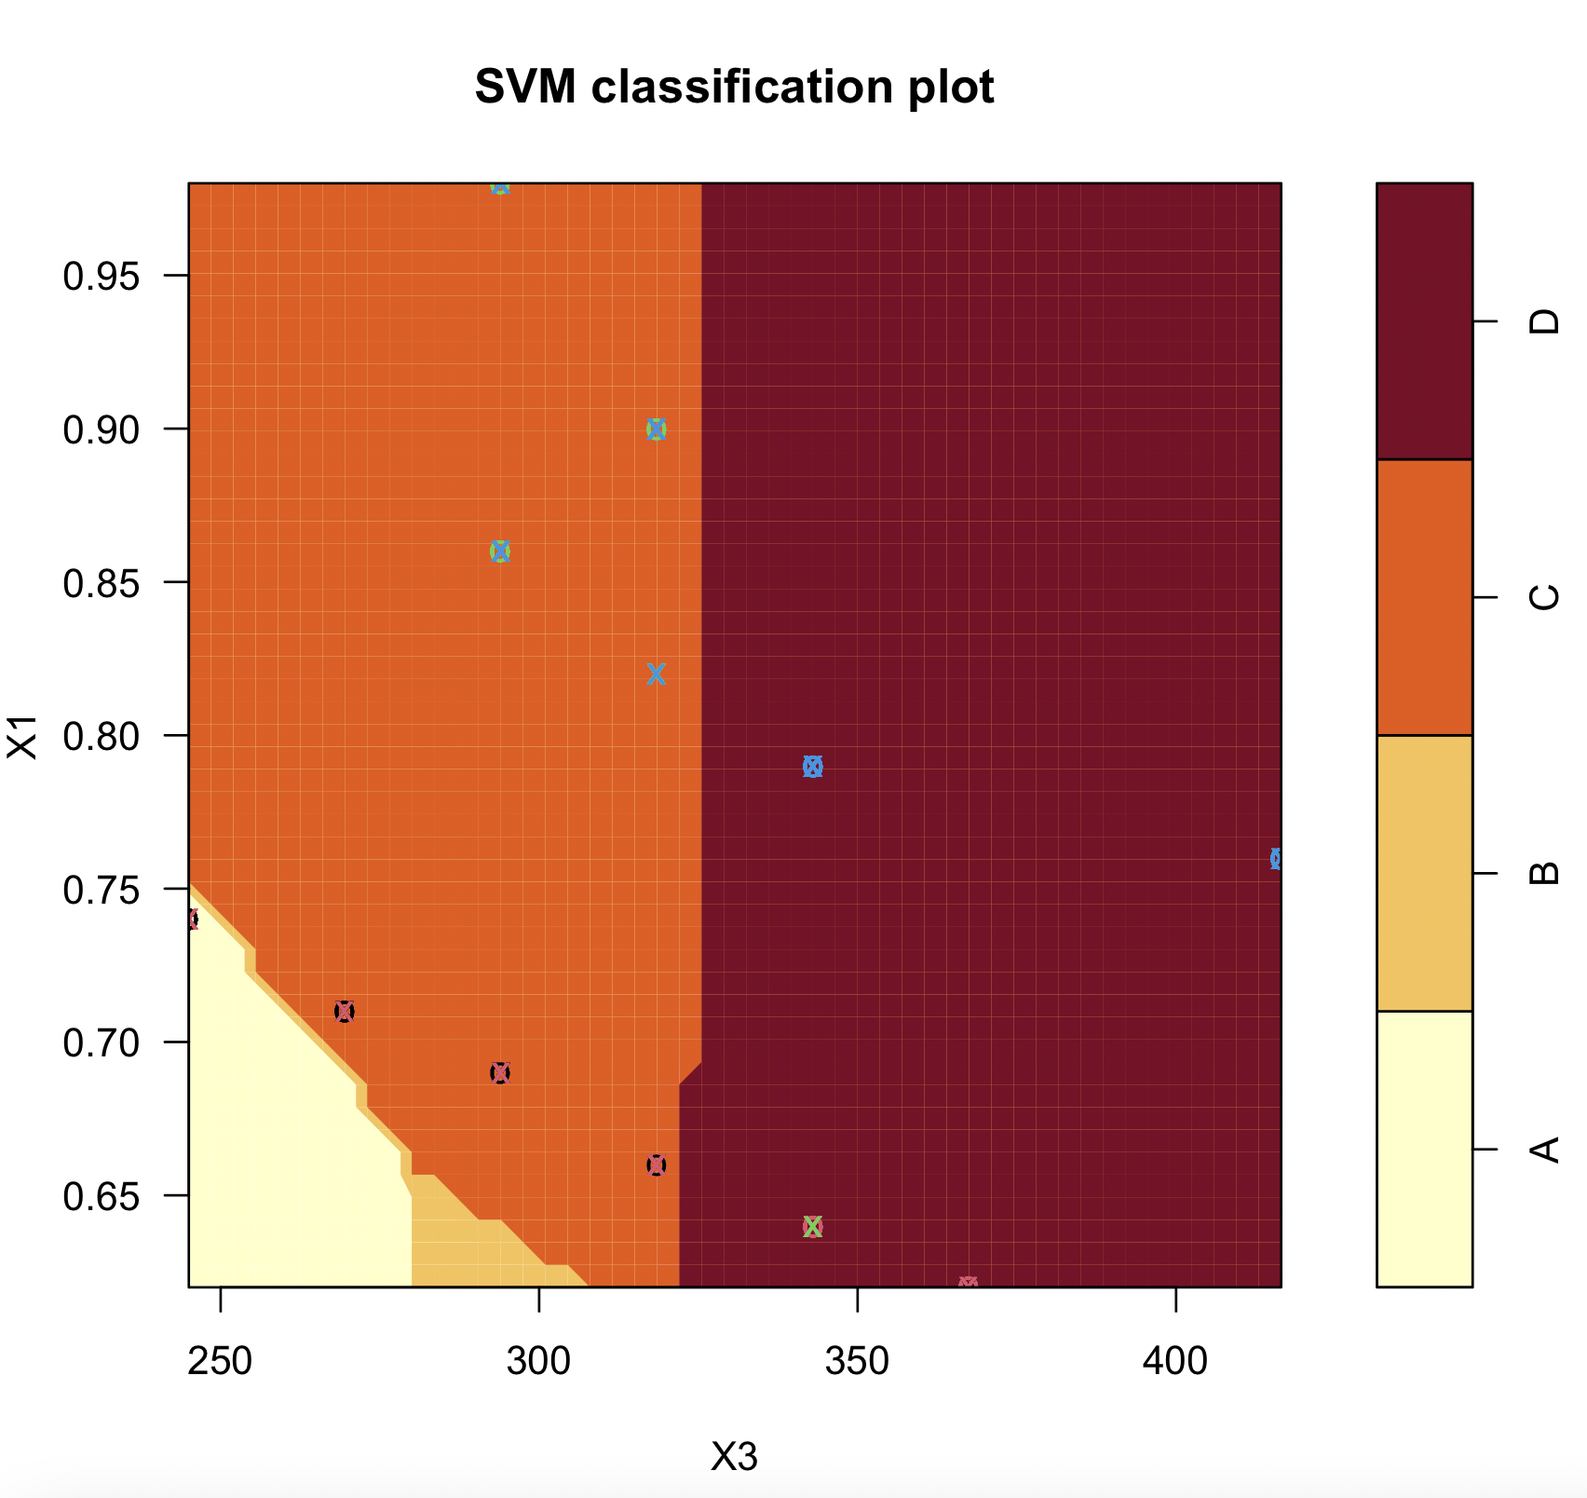
Support Vector Machine – Model 2

Slide 29
Neural Network with Multiple Outputs
Neural networks uses logistic function and add hidden layer in the model
We have used neural networks with multiple layers and nodes
Neural network is giving out output for Heating Load and Cooling Load

Slide 30


Single layer Neural Network
It is a single layer neural network with 5 hidden nodes. Here, the 5th node has the best accuracy.

Slide 31

Visual Representation of the Neural Network

Slide 32


Two-layer Neural Network

Slide 33


Visual Representation of the Neural Network

Slide 34
Accuracy Comparison
Neural Network with 1 layer and 1 to 5 hidden nodes, Most accurate was with 1 layer and 5 hidden node.
Neural Network with 2 layers and 1 to 5 hidden nodes in first layer and 4 hidden nodes in second layer
Most accurate was 5 nodes in 1st hidden layer and 4 nodes in 2nd hidden layer with accuracy of 98.8%

Slide 35


K-Nearest Neighbor Analysis
The k-nearest neighbor technique is a clustering algorithm that uses the k data points closest to a new data point to classify it into a group.
The algorithm uses training data to learn how to classify the labeled data points into categories.

Slide 36



K-NN for Heating Load
The model's overall accuracy is 80.09%, which is significantly good.
The p-value is very close to zero, supporting the statistical significance of the model's performance.

Slide 37



K-NN for Cooling Load
The overall accuracy of this model is 74.46. This indicates a moderate level of agreement between the model's predictions and the actual classes. The p-value suggests that the accuracy is significantly good.

Slide 38
Naïve Bayes
Naïve Bayes is a supervised machine learning algorithm that helps computer classify samples based on prior knowledge.
Predictors in a naïve bayes model are assumed to be conditionally independent.
All features are independent meaning that one feature does not affect the probability of another feature.
Every feature gets same level of importance.

Slide 39


Naïve Bayes for Heating Load

Slide 40


Naïve Bayes for Cooling Load

Slide 41
Which was the best model ?
Perceptron Accuracies
- Heating: 44.15%, 43.29%, 44.15%, 39.82%, 43.72%
- Cooling: 42.85%, 44.58%, 44.58%, 45.88%, 42.85%
Neural Network
- Single Layer: 96.44%
- Two Layer: 98.87%
K Nearest Neighbor
- Heating: 80.09%
- Cooling: 74.46%
Our Neural Network Model with 2 hidden layers, 5 nodes in layer 1 and 4 nodes in layer 2 worked the best.
SVM Accuracies
- Model1: 80.95%
- Model 2: 79.65%
Naïve Bayes
- Heating: 47.18%
- Cooling: 51.08%

Slide 42
Lessons Learnt
Visualization helps if data has less attributes , data visualization cannot help if data has multicollinearity, it can lead to misinterpretation.
Visualization doesn’t help if data is too complex or cluttered to understand without numbers. For such data plotting a correlation matrix is helpful as it highlights any higher or weaker relationship between variables.
Neural networks can have multiple inputs and multiple outputs.
Through our output we can see that having multiple layers can increase the accuracy of the model, but it may not be right for all data.

Slide 43
Recommendation for builders for Energy Efficient buildings
As Surface area increases it is harder to heat or cool down the building.
Buildings that have more levels or are more in height will take more energy for heating or cooling.
Glazing Area increases heating and cooling load of a building, it will vary depending on the region and windows in a building.
Relative Compactness of a building heavily affects the heating and cooling load. If a building has symmetrical shape like a cube, it will be easier for heating or cooling.

Slide 44
Recommendation for builders for Energy Efficient buildings
Glazing area plays an important role in heating and cooling load of a building, so it is recommended to have south faced windows in cold region as natural light will help with heating of the building and decrease heating load of building, similarly if region has high temperatures in general, building should have less glazing area.
Some building insert hollow pipes in earth’s surface for heating and cooling of the building. Earth’s temperatures doesn’t change drastically with seasons (20-25 degree Celsius). In winters it will provide relatively warm air and in summers it will provide relatively cool air.
Experts recommend to use natural resources as much as possible as this will always increase energy efficiency of any building.
Prefer solar heating over water heating.
Switch to LED lights as they decrease the heating load of a building.

Slide 45

Joke

Slide 46

Thank You

